Slide 1

Welcome to Carabao Workshop

Slide 2

What the Hell is a Carabao?
Drunken Carabao Tour
From: http://siargaophilippines.com/drunken-carabao-tour

Slide 3
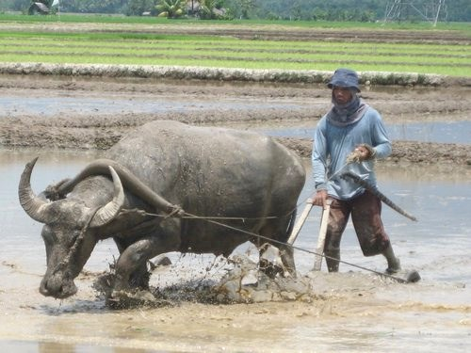
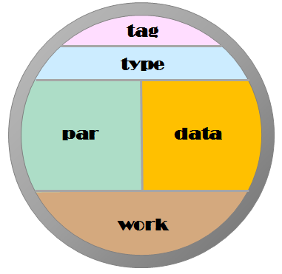
Carabao
carabao
domestic swamp type water buffalo
very powerful for Philippine farmers
Carabao
Matlab type ‚domestic‘ class object
very powerful for process, system & control engineers

Slide 4
Workshop Contents
Carbao is about toolbox engineering
About 70% of each toolbox is based on similar building blocks
Carabao Building Blocks
object manipulation (save, load, import, export, copy, cut, paste)
rapid setup of a roll down menu providing a user interface (the graphical shell)
manipulating and pre-processing of log data
Those building blocks are now condensed in the MATLAB® Carabao toolbox.

Slide 5
Workshop Contents
Day 1: Mission Possible
Day 2: Meeting with Carabao
Day 3: Time for Espresso
Day 4: Shell Hard Core
Day 5: Riding the Carabao

Slide 6
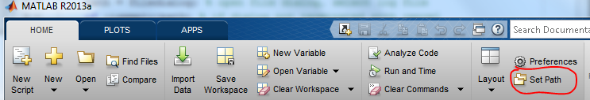
Supported Files
CaraMec.V1e.zip
Carabao/v1e (Carabao toolbox)
Doc (doc files)
Imec (sample files)
Move Toolbox Files to an “m-file location“
eg: m/Carabao/v1e
Set MATLAB path to toolbox folder

